Slide 1
Restaurant Business Analysis
Group 4
Shanu Mariam Joseph
Hirdeyjot Singh Bansi
Sebastian Campos
Amy Tieku

Slide 2
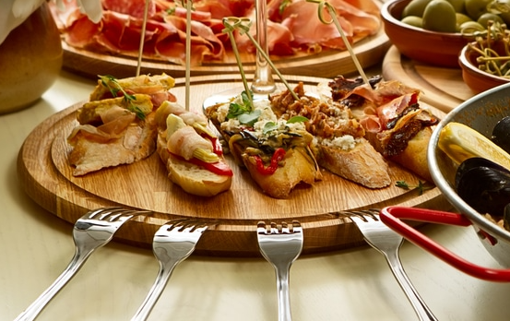
Purpose
The purpose of this project is to predict the star rating of the restaurant based on various attributes such as:
Quality
Price
etc

Slide 3
Reason for Choosing the Topic
With this project, we want to be able to help people search the best restaurants in a particular category in a particular city.

Slide 4
Description of the Source of Data
The Dataset came from Yelp. It contains 5 different json data files out of which we are just taking business.json and review.json files for our analysis. The rest of the data is out of scope for our analysis.
The business.json file contains business data including location data, attributes, categories and star ratings for the restaurants.
The review.json file contains review data including the user_id who wrote the reviews, the business_id for which the review is written and the star reviews for each of the restaurant.

Slide 5
DQuestions to be Answered With the Data
Are the star ratings correct based on number of reviews and other attributes?
Can we predict the average review per city per category?
What is the percentage for positive and negative reviews per city per category?
What are the top 5 restaurants in a city?

Slide 6
Communication Protocols
Zoom and Slack are the communication platforms used for discussion on the project. Meetings are conducted several times a week to assign project tasks, decide on technologies to be used and solve any challenges encountered during the process.

Slide 7
Technologies Used
Provisional Machine Learning Model
Python Libraries, PySpark and Google Collab will be used for machine learning.
Preprocessing
We are undecided about our machine learning model, as we have not gotten that far.
We are thinking of using categorical crossentrophy in a neural modell.

Slide 8
Technologies Used
Provisional Database
Postgres database hosted on Google Cloud.
Our tables are business reviews and business attributes, and they will joined (inner) by business ID.

Slide 9
Technologies Used
Data Cleaning and Analysis
Pandas will be used to clean the data and perform an exploratory analysis. Further analysis will be completed using PySpark.

Slide 10
Technologies Used
Database Storage
PostgreSQL is where data is stored and is hosted on the Google Cloud Platform.

Slide 11
Technologies Used
Dashboard
Tableau will be used to create interactive dashboards.
Which features affect star ratings the most?
We can conclude that x has the biggest effect on the star rating.
Linear regression (with high level polynomials).
Importance of each individual features?
We are thinking of users being able to select types of restaurants, or attributes of restaurants and predict their star rating.

Slide 12
Where we plan on being next week
Database set up
Get preprocessing code completed for the machine learning models
Decide what machine learning models to use
Decide what features to use
Have a draft of the Tableau built.

